Slide 1
Computer Networks
“COMMUNICATION LINKS & NETWORK DEVICES”
Asst. Lect. Ahmed M. Jasim
Computer Department - College of Engineering
University of Diyala
2017

Slide 2
Presentation Outline
Communication links
Network devices
Collision domain
Broadcast domain

Slide 3
COMMUNICATION LINKS
A communications links can be defined as a pathway over which information can be conveyed.
Physical wire
Radio, Laser, Other radiated energy source
In between the transmitter and the receiver, the transmission medium of the data, this is usually called as the channel of a communication system.

Slide 4
COMMUNICATION LINKS
The communication through links can be classified as:
1- Simplex
EX: Radio station and T.V broadcasting

Slide 5
COMMUNICATION LINKS
2- Half-duplex
EX: Two persons talking to each other such that when speaks the other listens and vice versa.

Slide 6
COMMUNICATION LINKS
3- Full-duplex:
Ex: A discussion in a group without discipline.

Slide 7
NETWORK DEVICES
Devices that interconnect different computer together.
Computer networking devices are known by different names such as networking devices, networking hardware, network equipment etc.
They work at different layers of the computer networks.

Slide 8
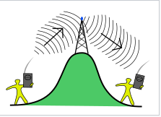
NETWORK DEVICES
1- Repeater (The physical layer device)
A repeater is an electronic device that receives a signal and retransmits it at a higher level and/or higher power, or onto the other side of an obstruction
Repeaters are majorly employed in long distance transmission to reduce the effect of attenuation.
It is important to note that repeaters do not amplify the original signal but simply regenerate it

Slide 9
NETWORK DEVICES
2- Modem (Physical layer device)
A modem stands for (Modulator + Demodulator).
Modulates and demodulates the signal between the digital data of a computer and the analog signal of a telephone line.

Slide 10
NETWORK DEVICES
3- Hub (Physical layer device)
Hubs connect computers together in a star topology network.
Due to their design, they increase the chances for collisions.
Hubs have no intelligence.
Hubs flood incoming packets to all ports all the time.
Hubs pose a security risk since all packets are flooded to all ports all the time.

Slide 11
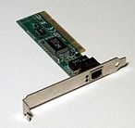
NETWORK DEVICES
4- NIC (Physical & Data link layer device)
A network interface card is a computer hardware component designed to allow computers to communicate over a computer network.
Provides a low-level addressing system through the use of MAC addresses.
Most motherboards today come equipped with a network interface card in the form of a controller.

Slide 12
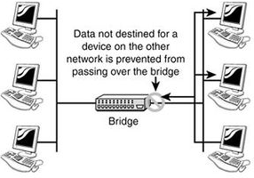
NETWORK DEVICES
5- Bridge (Data link layer device)
Bridges have intelligence and can "bridge" two of their ports together at very high speed.
They use a database of MAC addresses.
A bridge simply watches the incoming
frame and memorizes the MAC address
and port a frame arrives on.
If a frame arrives at the bridge
and the bridge does not know where to send it, the bridge will flood the frame just like a hub does.

Slide 13
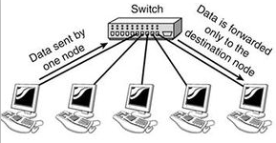
NETWORK DEVICES
6- Switch (Data link layer device)
Similar to a hub, switches provide a central connection between two or more computers on a network, but with some intelligence.
A switch forwards data only to the port on which the destination system is connected.
They use a database of MAC addresses.

Slide 14
NETWORK DEVICES
Computer that the switch does not have an address for in its MAC address table, it will flood the packet out all connected ports.
A switch creates separate collision domains for each physical connection.
A broadcast received on one port will be flooded out all ports except the one it came in on

Slide 15
NETWORK DEVICES
7- Router (Network layer device)
Routers efficiently route information between Local Area Networks.
A router will divide a broadcast domain and have traffic filtering capabilities
A router uses IP addresses to figure out where to send packets. If two hosts from different networks want to communicate, they will need a router between them to route packets

Slide 16
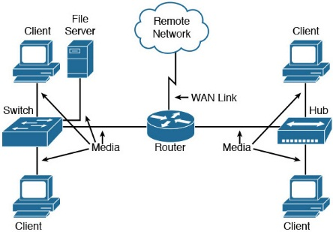
NETWORK DEVICES

Slide 17
COLLISION DOMAIN & BROADCAST DOMAIN
1- Collision domain
A collision domain is, as the name implies, a part of a network where packet collisions can occur.
A collision occurs when two devices send a packet at the same time on the shared network segment.
Collisions are often in a hub environment, because each port on a hub is in the same collision domain.
By contrast, each port on a bridge, a switch or a router is in a separate collision domain.

Slide 18
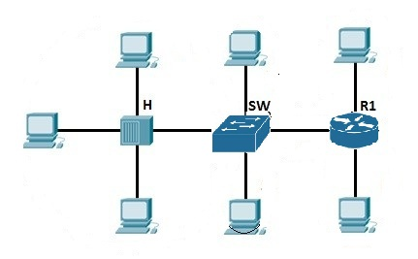
COLLISION DOMAIN & BROADCAST DOMAIN
1- Collision domain

Slide 19
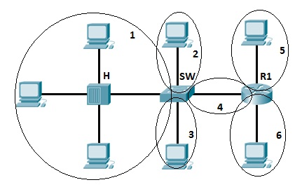
COLLISION DOMAIN & BROADCAST DOMAIN
1- Collision domain

Slide 20
COLLISION DOMAIN & BROADCAST DOMAIN
2- Broadcast domain
A broadcast domain is a domain in which a broadcast is forwarded.
A broadcast domain contains all devices that can reach each other at the data link layer (OSI layer 2) by using broadcast.
All ports on a hub or a switch are by default in the same broadcast domain.
All ports on a router are in the different broadcast domains and routers don’t forward broadcasts from one broadcast domain to another

Slide 21
COLLISION DOMAIN & BROADCAST DOMAIN
2- Broadcast domain

Slide 22
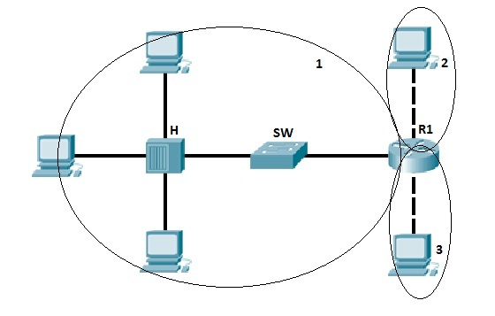
COLLISION DOMAIN & BROADCAST DOMAIN
2- Broadcast domain

Slide 23
THANK YOU

